Slide 11
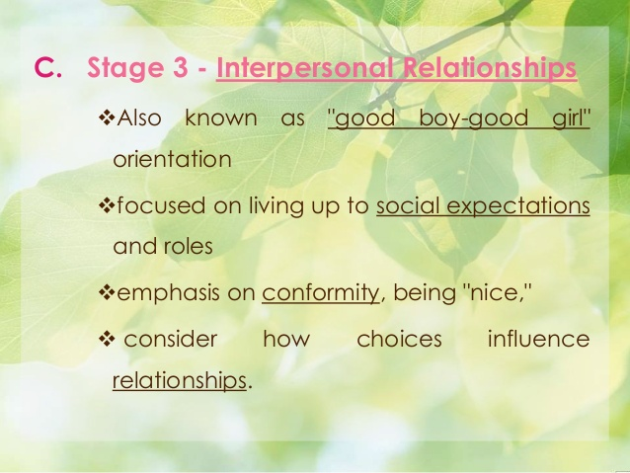

Slide 18
THANK YOU
ALL OF MY STUDENTS

